Slide 1



Build Interactive Web App with R & Shiny
Prepared by : Aep Hidayatuloh
Email : aephidayatuloh.mail@gmail.com
GitHub : https://github.com/aephidayatuloh
RPubs : https://rpubs.com/aephidayatuloh

Slide 2

Syllabus
Pertemuan | Kompetensi Dasar | Materi
6 | Mampu membuat aplikasi shiny dengan fitur login | Membuat aplikasi dengan fitur login
 |  | Pengenalan package {shinymanager} untuk membuat fitur login
 |  | Membuat database untuk penyimpanan data user login
 |  | Akses Admin database user
 | Presentasi rencana tugas akhir | Presentasi rencana tugas akhir

Slide 3

Authentication & Securitty

Slide 4

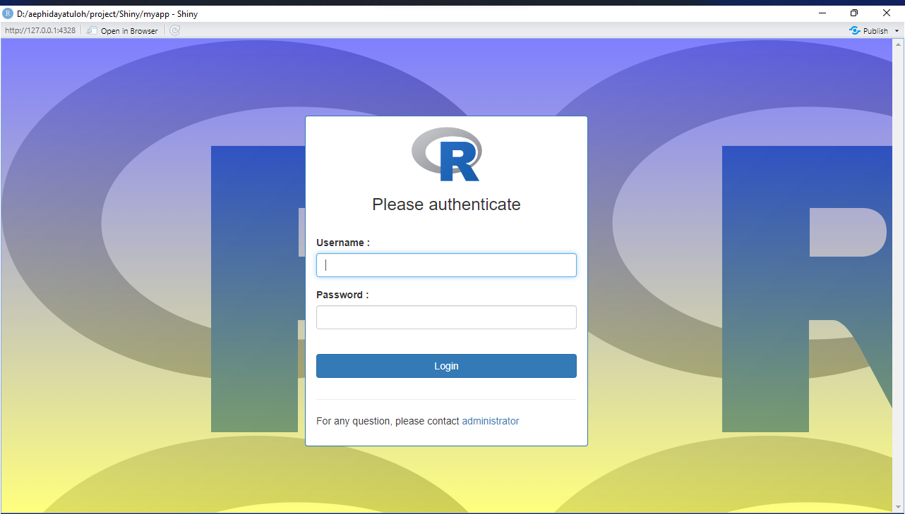
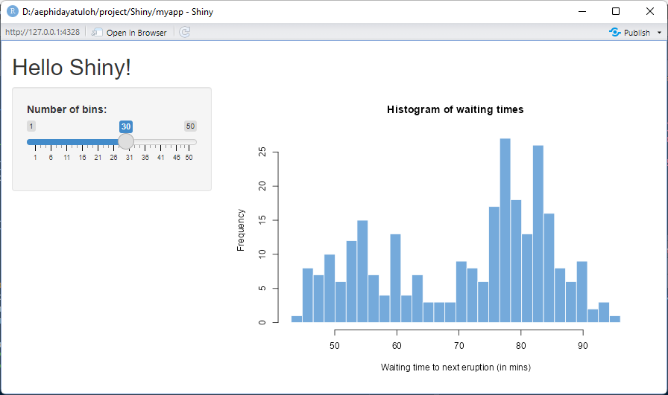

Authentication Using
Use login module for authentication
Secure the shiny apps and control who can access it
install.packages("shinymanager")

Slide 5



User Database
{shinymanager} user table source:
User table
user* | password* | admin | start | expire | <additional column(s)>
admin | ******
user1 | ******
user2 | ******
user3 | ******
Dataframe
Static Database
Static/Dynamic Database
* mandatory
{shinymanager} Documentation:
https://datastorm-open.github.io/shinymanager/
Free online database (PostgreSQL):
https://www.elephantsql.com/
Use SQLite database to use all features of {shinymanager}

Slide 6
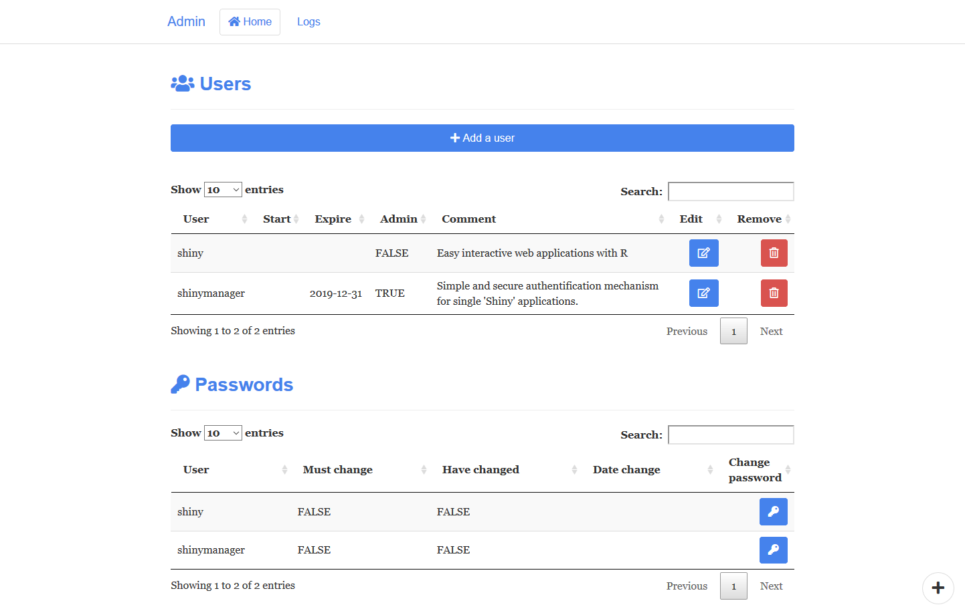

Feature
Login page
Use SQLite database can access admin page to control users
User change password page (SQLite only)

Slide 7
Demo: Use Dataframe
credentials <- data.frame(
user = c("shiny", "shinymanager"), # mandatory
password = c("azerty", "12345"), # mandatory
start = c("2019-04-15"), # optinal (all others)
expire = c(NA, "2019-12-31"),
admin = c(FALSE, TRUE),
stringsAsFactors = FALSE
)
library(shiny)
library(shinymanager)
ui <- fluidPage(…)
ui <- secure_app(ui)
server <- function(input, output, session){
result_auth <- secure_server(
check_credentials = check_credentials(credentials)
)
user <- reactive(result_auth$user)
# your server script
}

Slide 8
Demo: Use SQLite
credentials <- data.frame(
user = c("shiny", "shinymanager"), # mandatory
password = c("azerty", "12345"), # mandatory
start = c("2019-04-15"), # optinal (all others)
expire = c(NA, "2019-12-31"),
admin = c(FALSE, TRUE),
stringsAsFactors = FALSE
)
library(shiny)
library(shinymanager)
create_db(
credentials_data = credentials,
sqlite_path = "path/to/database.sqlite")
ui <- fluidPage(…)
ui <- secure_app(ui, enable_admin = TRUE)
server <- function(input, output, session){
result_auth <- secure_server(
check_credentials = check_credentials(
"path/to/database.sqlite"
)
)
user <- reactive(result_auth$user)
# your server script
}

